Slide 1
VPN & IPsec
A presentation on
Submitted to
Mr. Nirmal Roberts
Submitted by-
Prabhakar d damor (2014 IS-16)
Prateek Agarwal (2014 IS-18 )
Vishwa Vijay Verma (2014 IS-24)

Slide 2

Virtual Private Networks and IPSEC
IPSEC provides three main facilities:
an authentication-only function called the Authentication Header (AH)
combined authentication/encryption function called Encapsulating Security Payload (ESP)
key exchange functionality
Notes:
Virtual private networks (VPNs) and IPsec (Internet Protocol Security) were introduced in Chapter 18, where we looked at the applications and benefits of IPsec. This section provides some of the technical details.
IPsec Functions
IPsec provides three main facilities: an authentication-only function referred to as Authentication Header (AH), a combined authentication/encryption function called Encapsulating Security Payload (ESP), and a key exchange function. For VPNs, both authentication and encryption are generally desired, because it is important both to (1) assure that unauthorized users do not penetrate the virtual private network, and (2) assure that eavesdroppers on the Internet cannot read messages sent over the virtual private network. Because both features are generally desirable, most implementations are likely to use ESP rather than AH. The key exchange function allows for manual exchange of keys as well as an automated scheme.
The current specification requires that IPsec support the Data Encryption Standard (DES) for encryption, but a variety of other encryption algorithms may also be used. Because of concern about the strength of DES, it is likely that other algorithms, such as triple DES, will be widely used. For authentication, a relatively new scheme, known as HMAC, is required.

Slide 3
Transport & Tunnel Modes
Encapsulating Security Payload (ESP) supports two modes of use:
Transport
which provides protection for upper-layer protocols
typically used for end-to-end communication between two hosts
Tunnel
which provides protection to the entire IP packet
used when at least one of the two ends is a security gateway
Notes:
Transport and Tunnel Modes
ESP supports two modes of use: transport and tunnel mode.
Transport mode provides protection primarily for upper-layer protocols. That is, transport mode protection extends to the payload of an IP packet. Typically, transport mode is used for end-to-end communication between two hosts (e.g., a client and a server, or two workstations). ESP in transport mode encrypts and optionally authenticates the IP payload but not the IP header (Stallings DCC9e Figure 24.1b). This configuration is useful for relatively small networks, in which each host and server is equipped with IPsec. However, for a full-blown VPN, tunnel mode is far more efficient.
Tunnel mode provides protection to the entire IP packet. To achieve this, after the ESP fields are added to the IP packet, the entire packet plus security fields is treated as the payload of new "outer" IP packet with a new outer IP header. The entire original, or inner, packet travels through a "tunnel" from one point of an IP network to another; no routers along the way are able to examine the inner IP header. Because the original packet is encapsulated, the new, larger packet may have totally different source and destination addresses, adding to the security. Tunnel mode is used when at least on of the two ends is a security gateway, such as a firewall or router that implements IPsec. With tunnel mode, a number of hosts on networks behind firewalls may engage in secure communications without implementing IPsec. The unprotected packets generated by such hosts are tunneled through external networks by using tunnel mode, set up by the IPsec software in the firewall or secure router at the boundary of the local network.

Slide 4
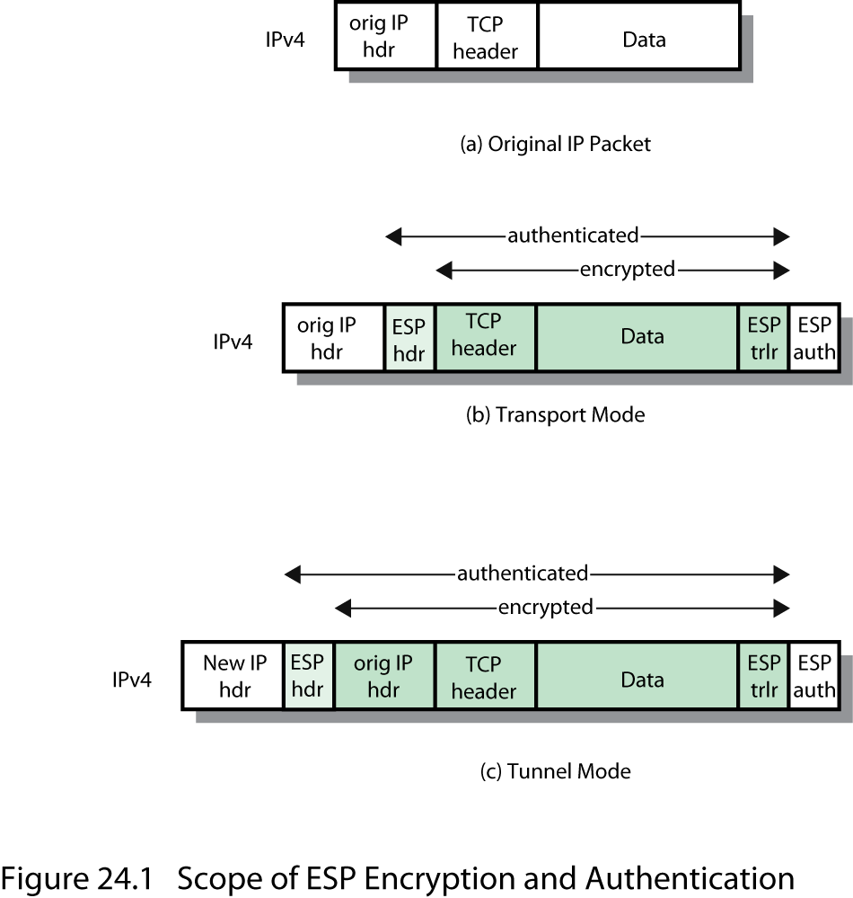
ESP Encryption and Authentication
Notes:
As shown in Stallings DCC9e Figure 24.1, ESP in transport mode encrypts and optionally authenticates the IP payload but not the IP Header

Slide 5


Example of Tunnel Mode
Host B
Host A
IPSEC Processing Needed?
Outer IP
Header is
Stripped
Notes:
Here is an example of how tunnel-mode IPsec operates. Host A on a network generates an IP packet with the destination address of host B on another network. This packet is routed from the originating host to a firewall or secure router at the boundary of A's network. The firewall filters all outgoing packets to determine the need for IPsec processing. If this packet from A to B requires IPsec, the firewall performs IPsec processing and encapsulates the packet in an outer IP header. The source IP address of this outer IP packet is this firewall, and the destination address may be a firewall that forms the boundary to B's local network. This packet is now routed to B's firewall, with intermediate routers examining only the outer IP header. At B's firewall, the outer IP header is stripped off, and the inner packet is delivered to B.
ESP in tunnel mode encrypts and optionally authenticates the entire inner IP packet, including the inner IP header.

Slide 6
Key Management
IPSEC key management involves the determination and distribution of secret keys.
IPSEC supports 2 types of key management
Manual – requires a system administrator to manually configure the systems and corresponding keys
Automated – no human intervention needed and enables on-demand creation of keys
Notes:
Key Management
The key management portion of IPsec involves the determination and distribution of secret keys. The IPsec Architecture document mandates support for two types of key management:
Manual: A system administrator (SA) manually configures each system with its own keys and with the keys of other communicating systems. This is practical for small, relatively static environments.
Automated: An automated system enables the on-demand creation of keys and facilitates the use of keys in a large distributed system with an evolving configuration. An automated system is the most flexible but requires more effort to configure and requires more software, so smaller installations are likely to opt for manual key management.

Slide 7

IPSEC and VPNs
there is a driving need for users and organizations to be able to:
secure their networks
receive traffic over the internet while still meeting the need to secure the network
Notes:
IPsec and VPNs
The driving force for the acceptance and deployment of secure IP is the need for business and government users to connect their private WAN/LAN infrastructure to the Internet for (1) access to Internet services, and (2) use of the Internet as a component of the WAN transport system. Users need to secure their networks and at the same time send and receive traffic over the Internet. The authentication and privacy mechanisms of secure IP provide the basis for a security strategy.
Because IP security mechanisms have been defined independent of their use with either the current IP or IPv6, deployment of these mechanisms does not depend on deployment of IPv6. Indeed, it is likely that we will see widespread use of secure IP features long before IPv6 becomes popular, because the need for IP-level security is greater than the need for the added functions that IPv6 provides compared to the current IP.

Slide 8
Ipsec and VPNs
IPsec provides the network manager with complete control over the security aspects of VPN
can be implemented in routers or firewalls owned and operated by the organization
a service provider can simplify the job of planning, implementing, and maintaining Internet-based VPNs for secure access and secure communication
Notes:
With the arrival of IPsec, managers have a standardized means of implementing security for VPNs. Further, all of the encryption and authentication algorithms, and security protocols, used in IPsec are well studied and have survived years of scrutiny. As a result, the user can be confident that the IPsec facility indeed provides strong security.
IPsec can be implemented in routers or firewalls owned and operated by the organization. This gives the network manager complete control over security aspects of the VPN, which is much to be desired. However, IPsec is a complex set of functions and modules and the management and configuration responsibility is formidable. The alternative is to seek a solution from a service provider. A service provider can simplify the job of planning, implementing, and maintaining Internet-based VPNs for secure access to network resources and secure communication between sites.

